Slide 1
SAS BUSINESS PROJECT
Presentation Date : 24th March, 2021
Instructor : Arkar Min
Submitted By : Rima Nigam

Slide 2
PROJECT OUTLINE
1
INTRODUCTION OF THE DATASET
2
BACKGROUND & BUSINESS QUESTIONS
3
OBJECTIVES OF THE ANALYSIS
4
5
DESCRIPTIVE ANALYSIS
6
HYPOTHESIS TESTING
METHODOLOGY.
7
8
CONCLUSIONS & RECOMMENDATIONS
9
APPENDIX
MODELLING & MODEL FINDINGS

Slide 3
INTRODUCTION
The Bank dataset contains customer's information, history of their transactions and the behaviour of the customers.
The Analysis will be conducted to find out the reason behind the customers becoming Inactive.
Most of the variables in this dataset are binary class.
Key Attributes of the Dataset:
Account Types – Checking Account, Saving Account
Income/Age/Credit Score of the customers.
Bank Products (Checking, Credit Cards, Insurance, Loan, Mortgage, Money Market)
Banking habits : Checks, Telephone , Teller visit, Point of sales
Different Branches of the banks.
The major point in this research is :
Profiling customers according to their profitability for bank.
With the analysis of profiles we can answer to the questions
that make banks successful in their business.
Total Observations | 32,264
Total Variables | 48 Numeric – 46 , Character - 2

Slide 4
Executive Summary
This report is part of a SAS Business project, as a capstone for the Data Science and Application Program. The final goal is to predict status of the customers as Active and Inactive based on the Customer’s details. The aim of this report is to explain how to explore, validate and prepare the data and build a significant model for prediction purpose. All steps are going to be explained and supported by SAS codes including SAS Macros and procedures.

Slide 5

BACKGROUND & BUSINESS QUESTIONS
Time Period : The bank customers data was collected between Jan 2014-December 2014. It provided the information on active and inactive customer profiles.
BUSINESS QUESTIONS
Do the Banking habits like the Telephone Banking, Teller visits, Number of checks, Point of Sales let the customers to become active or inactive?
Will the complimentary Direct Deposit Facility help to retain the customers?
Do the card users’ customers stays with the bank for a longer period of time?
Do the customers having loan with the bank comes out to be the loyal customers?
What age group of customers are the most active customers?
Which Branches of the Bank is doing well and able to retain the customers?

Slide 6
Objectives of this Project
The foremost aim of Profiling bank customer’s data is that it will cognize the issuer's decisions about whom to give banking facilities and what a credit limit to provide.
Through this project, the issuers will be able to get a better understanding of their potential and current customers.
This project will help in finding the best technique, which will lead to improvement in accuracy and helps banks to get higher profitability by customer satisfaction through a focus on the valuable customer which are considered as the main engine in the bank's profitability.

Slide 7
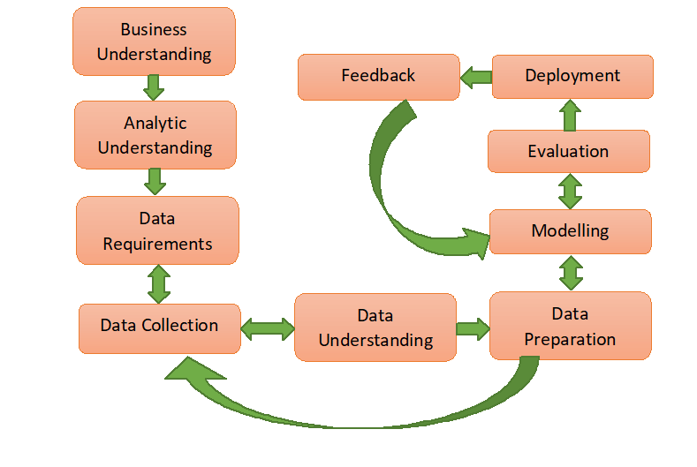
Methodology
Data Collection : The Bank data about the Customers is primarily collected and consolidated directly from the customers. By directly analyzing the feedback of its customers, financial banking institutions can provide personalized products and services tailored to their customer needs.
Data Definition : After gathering the necessary data, the data has been analyzed based on the behavior of the customers. In this project, we are going to predict the Active/Inactive customers. This Methodology contains six phases:
Software Used : SAS 9.4 Software is used to conduct this research.
Statistical Techniques : Logistic Regression, SAS Macros, procedures and functions.

Slide 8
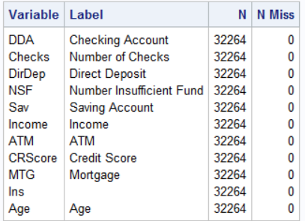
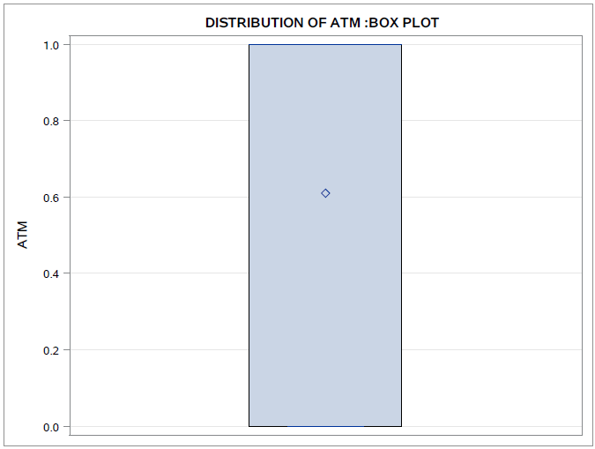
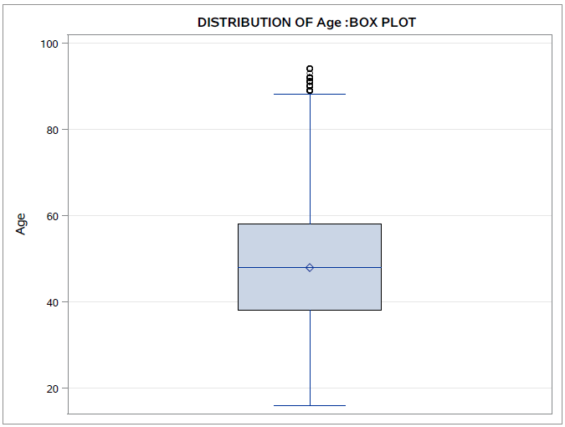
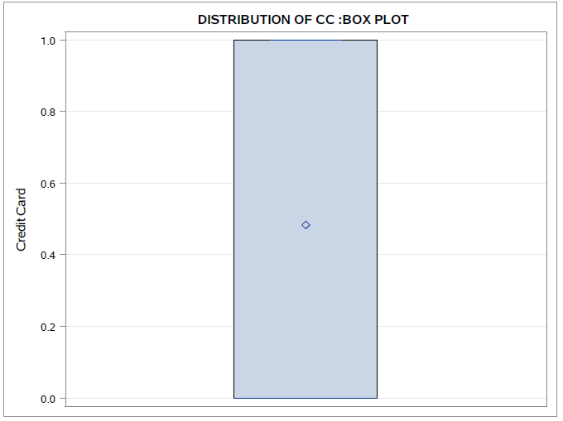
DATA VALIDATION
MISSING VALUES AND OUTLIER TREATMENT

Slide 9
Study Framework : Y and X variables
INDEPENDENT VARIABLES
MEDIATING VARIABLE
DEPENDENT VARIABLE
Age
Branch
Bank Area
ATM
BANK SERVICES & OFFERS
Active/Inactive Customers(DDA)
Credit Card
Phone , Teller
NSF
Credit Score
Checks
Direct Deposit
Mortgage

Slide 10
DESCRIPTIVE ANALYSIS

Slide 11
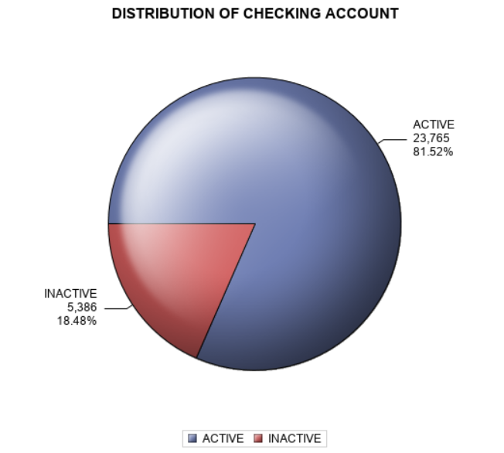
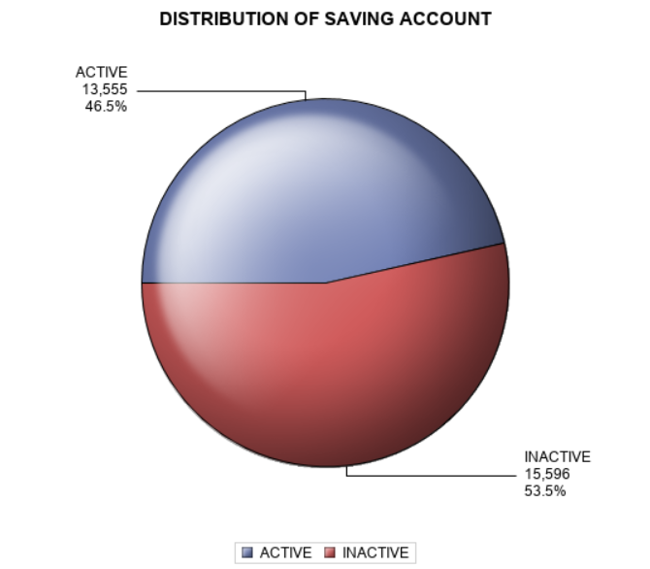
Which type of account customers are preferring to keep with the bank?
Conclusion: Customers are preferring to keep the checking account over saving account for their day to day transactions.

Slide 12
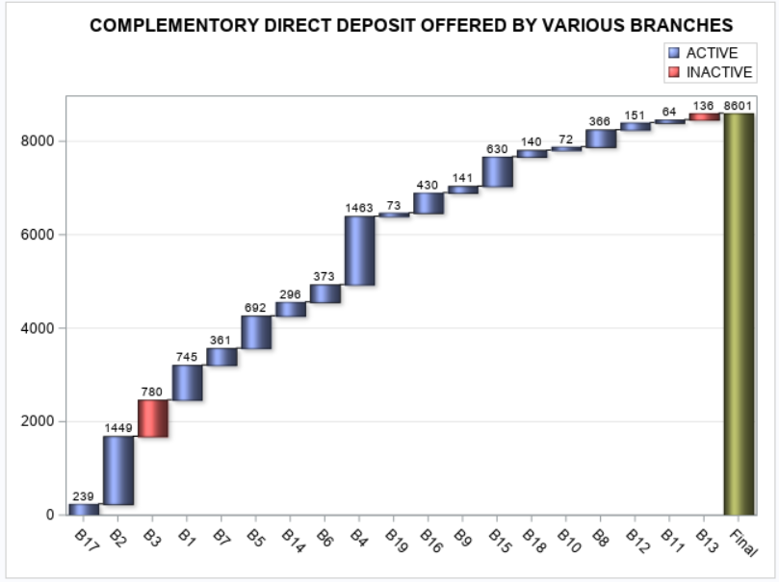
Which branches are offering the Direct Deposit Facility ?
Conclusion: As per this graph, maximum branches are not offering the direct deposit facility to deposit the funds electronically into a bank account or the customers are not preferring may be the bank is charging a certain amount for the deposits to take place between banks.

Slide 13
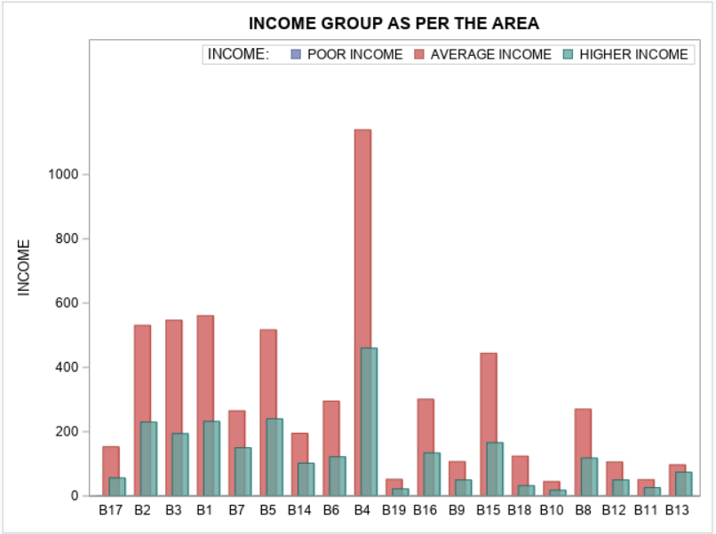
What Income group people are the most active customers in the different branches of the bank ?
Conclusion: As per this graph, Average income group customers are the most Active customers. The Branch B4 has the maximum number of Average Income customers.

Slide 14
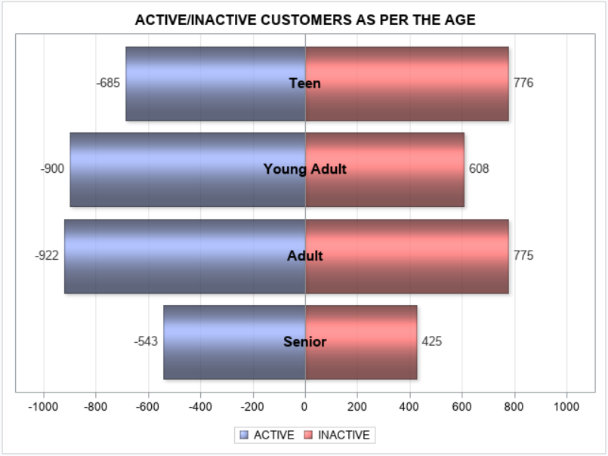
What age group of customers are the most active customers?
Conclusion: According to this graph, the most active customers falls under the ‘Teen’ and ‘Adult’ age group as they seems to do much transactions.

Slide 15
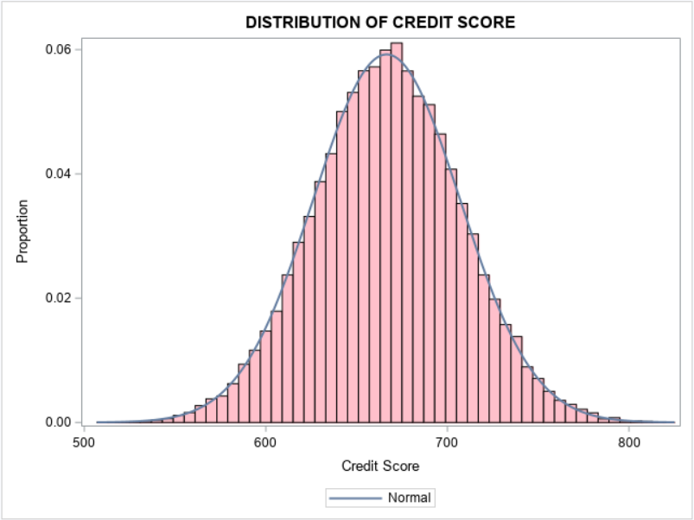
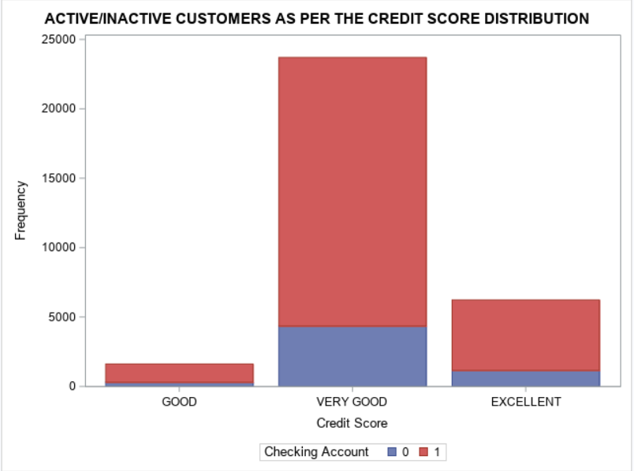
What is the distribution of Credit Score as per the Credit card users?
Conclusion: Maximum customers are having very good score between 600-700 as they are the most active customers because may be they are doing transactions on the regular basis.

Slide 16
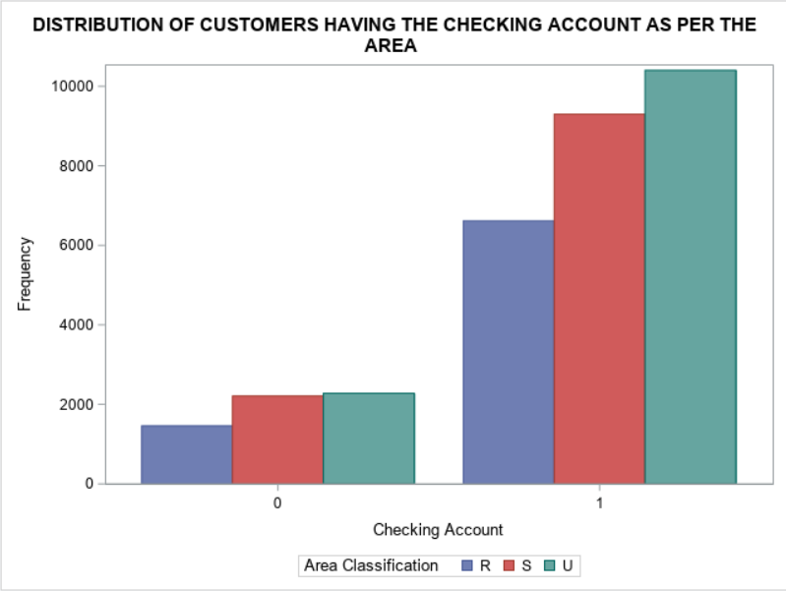
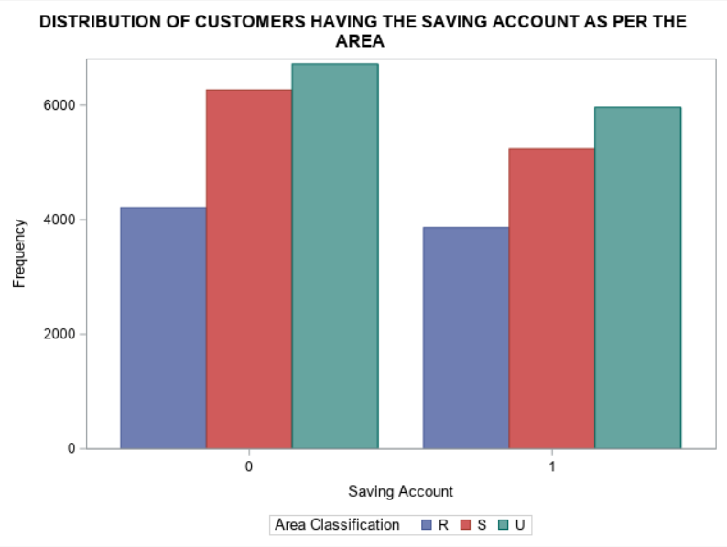
Which type of accounts customers are preferring based on the Area?
Conclusion: Maximum customers in Urban Areas are preferring to maintain the Checking Accounts over the Saving Accounts for daily transactions.

Slide 17
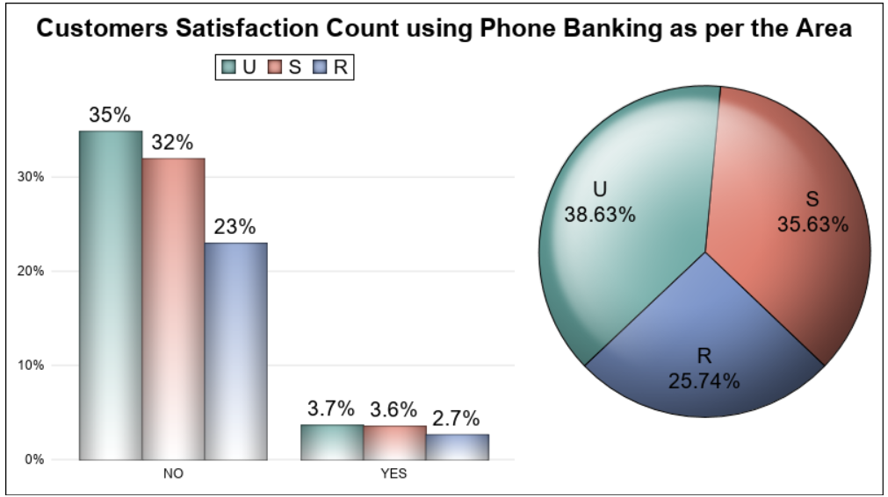
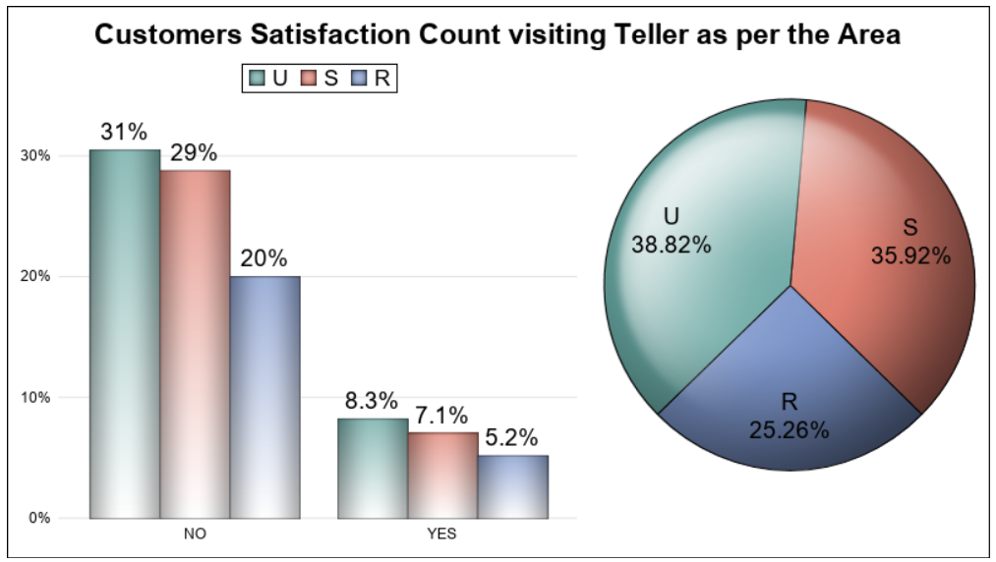
Is there any effect of Banking habits on customers becoming active or inactive?
Conclusion: The more the customers are using their phone banking and the teller visits, the more they are becoming inactive, may be because the customers are not satisfied with the services or they may not be able to solve their queries well neither through phone or in personal.

Slide 18
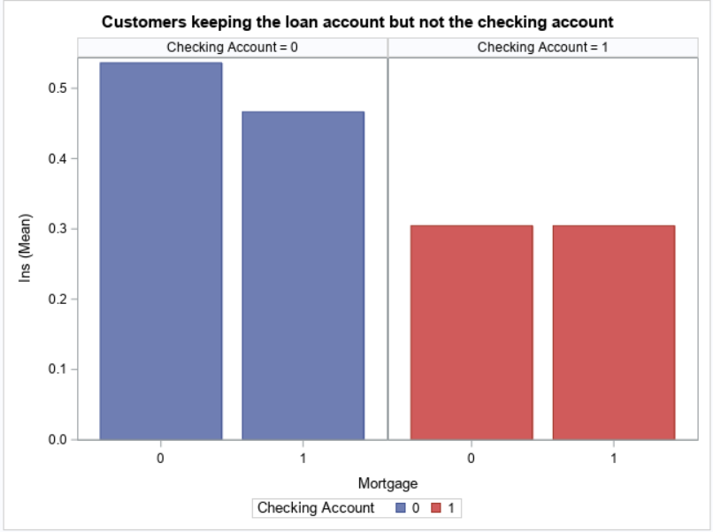
Do the customers with mortgage are the most loyal customers?
Conclusion: As per this graph, customers are only opening the loan account to apply for the mortgage but seems not to be an active customer. The reason could be either they are not liking the bank services but due to low rate of interest on loan they have opened the accounts.

Slide 19
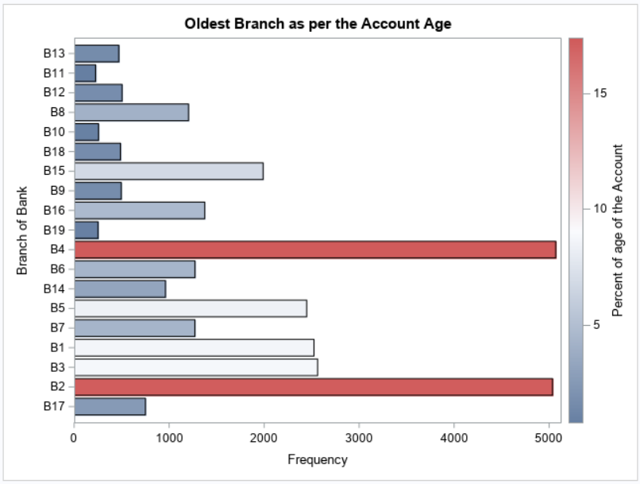
Which is the oldest Branch as per the age of the Account?
Conclusion: As we can see, B4 and B2 are the oldest branches as per the age of the Account.

Slide 20
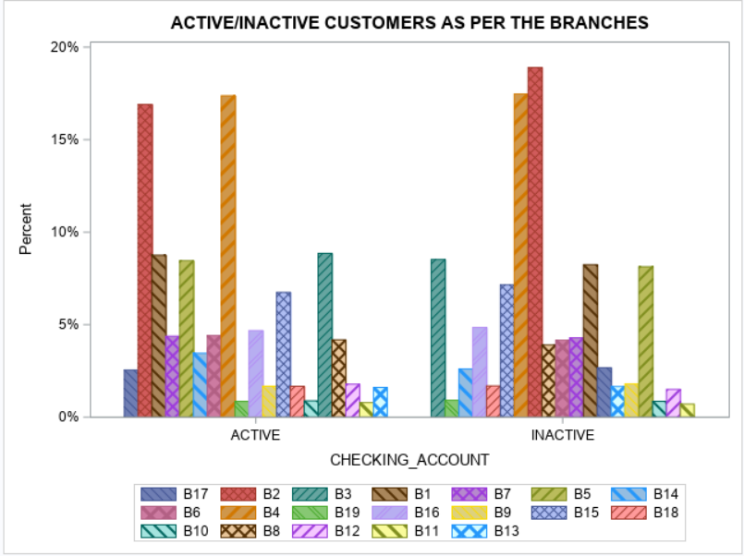
Which branch is having the maximum number of Inactive customers?
Conclusion: According to this graph, the branch B4 and B2 are having the maximum inactive customers. The bank must find the reason for the customer’s churn in order to find the way to retain the customers.

Slide 21
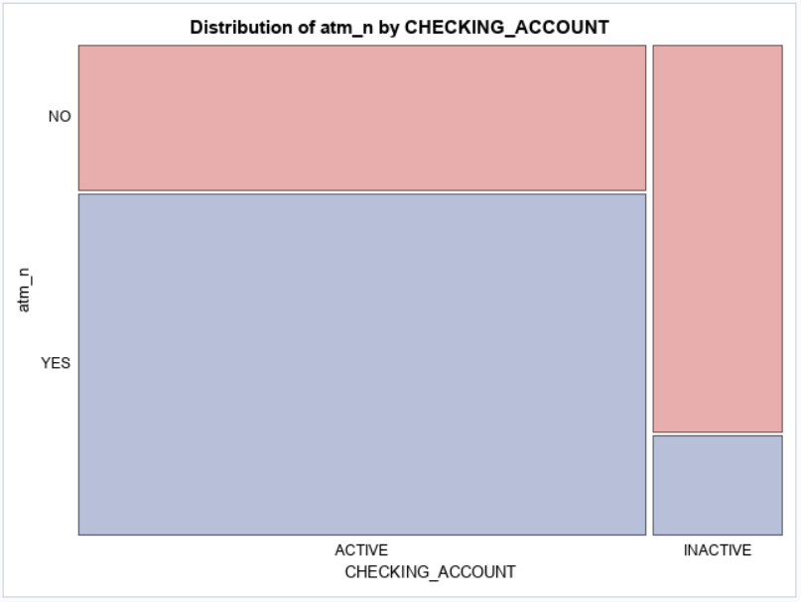
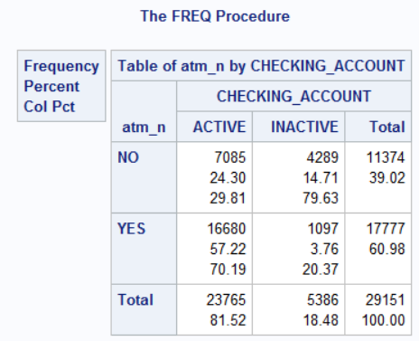
How many ATM users are the Active customers?
Conclusion: Most of the ATM users are the Active customers as they prefer to escape from long queues of Teller visits for withdrawing, deposit and transferring money

Slide 22
HYPOTHESIS TESTING

Slide 23
HYPOTHESIS TESTING
The hypothesis testing is a statistical test used to determine whether the hypothesis assumed for the sample of data stands true for the entire population or not.
Setting the Null Hypothesis (Ho) and the Alternative Hypothesis (Ha) at 5% Significance level
Ho : The Target variable is not having a relationship with the Independent Variables.
Ha : The Target variable is having a relationship with the Independent Variables.
Based on this dataset, I have prepared some hypothesis questions to answer in the next slide.
Does the customers having mortgage and loan installments turned out to the Active customers?
Are the banking habits – checks, phone, teller etc creating any impact on the status of the customers?
Will the Card users customers are the active customers?
Which variables are having relationship with the Target Variable?

Slide 24
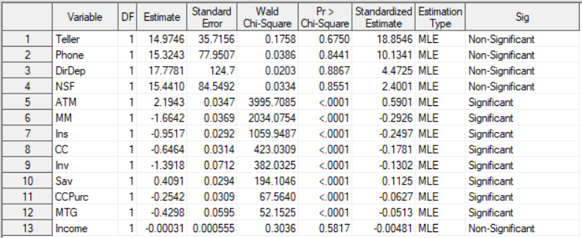
HYPOTHESIS TESTING
As the P-values of Mortgage and Instalment variable is less than 0.05. That shows these variables are helping the customers to remain Active.
The banking habits variable comes out to insignificant that means there is no relationship of them with the Target Variable.
Card user customers also turned out to be the Active customers.
Out of all variables selected, ATM, CC, Ccpurc, MTG, Ins shows the significant relationship with the target variable.

Slide 25
MODELLING

Slide 26
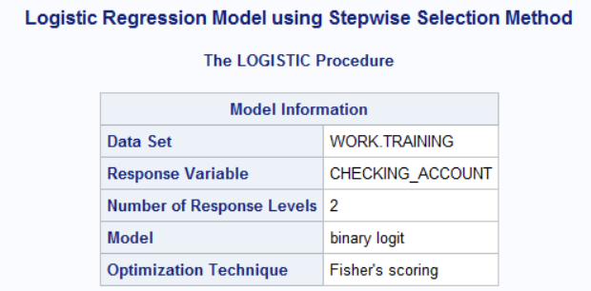
LOGISTIC REGRESSION MODEL BUILDING
Logistic regression describes the relationship between a categorical response variable and a set of predictor variables. A categorical response variable can be a binary variable, an ordinal variable or a nominal variable. Each type of categorical variables requires different techniques to model its relationship with the predictor variables.
In this dataset, I am having a binary response variable as Active/Inactive.
So, I have built a Logistic Regression Model using a Stepwise Selection Method.

Slide 27
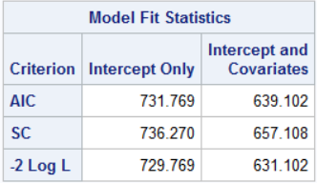
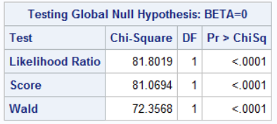
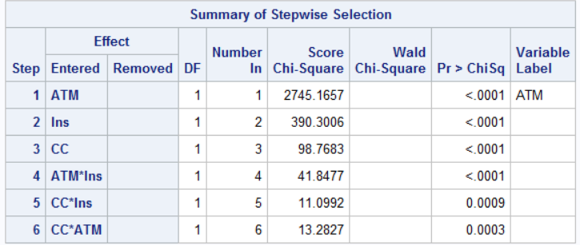
MODEL FINDINGS
Ultimately, the model with the smallest AIC is considered the best.
SC penalizes for the number of predictors in the model and the smallest SC is most desirable.
The -2 Log L is used in hypothesis tests for nested models.
Likelihood Ratio – This is the Likelihood Ratio (LR) Chi-Square test that at least one of the predictors’ regression coefficient is not equal to zero in the model.
Score – This is the Score Chi-Square Test that at least one of the predictors’ regression coefficient is not equal to zero in the model.
Wald – This is the Wald Chi-Square Test that at least one of the predictors’ regression coefficient is not equal to zero in the model.
After addition of all the selected variables into the model, the model selected the following variables and they are all significant as their p values are less than 0.05. As the model is predicting whether the customer is active or not so the card users and the customers having loan installments sounds more active.

Slide 28
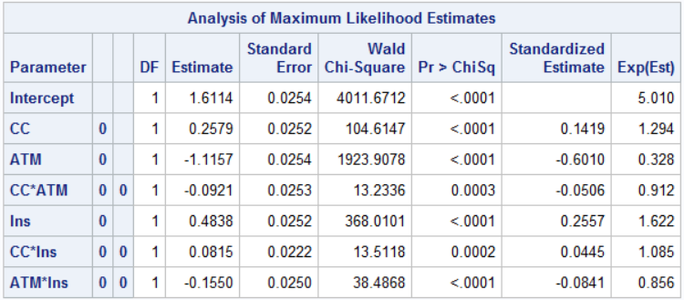
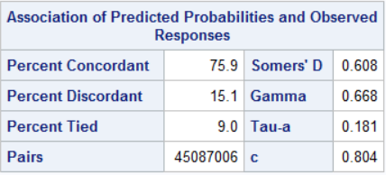
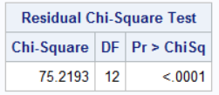
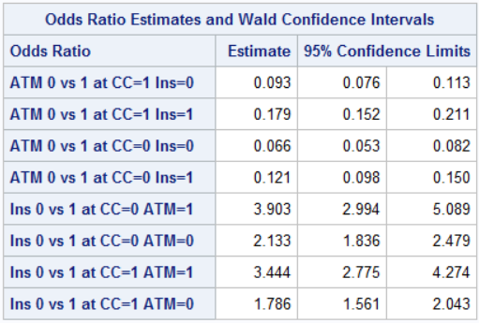
The logistic regression model models the log odds of a positive response as a linear combination the predictor variables. This is written as
log[ p / (1-p) ] = b0 + b1*x1 + b2*x2 + b3 *x3..,
Here all the variables are significant as their P-values are less than 0.05.
Percent Concordant – A pair of observations with different observed responses is said to be concordant if the observation with the lower ordered response value has a lower predicted mean score than the observation with the higher ordered response.
Percent Discordant – If the observation with the lower ordered response value has a higher predicted mean score than the observation with the higher ordered response value, then the pair is discordant.
Percent Tied – If a pair of observations with different responses is neither concordant nor discordant, it is a tie.
A confidence limit that contains 1 will not be significant.

Slide 29
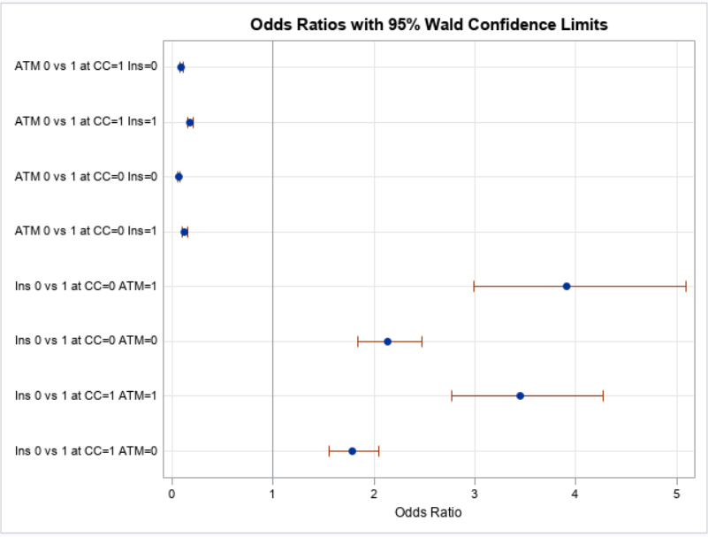
Odds Ratio Plot with 95% Wald Confidence Limit
Conclusion : The default odds ratio plot is shown. Four estimates are less than 1 and four are greater than 1. These four confidence intervals in contains 1, which indicates ratios that are not significant.

Slide 30
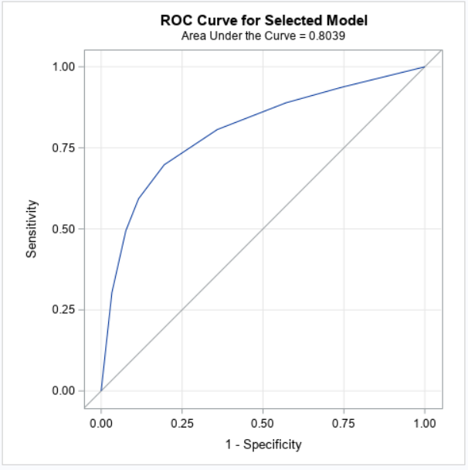
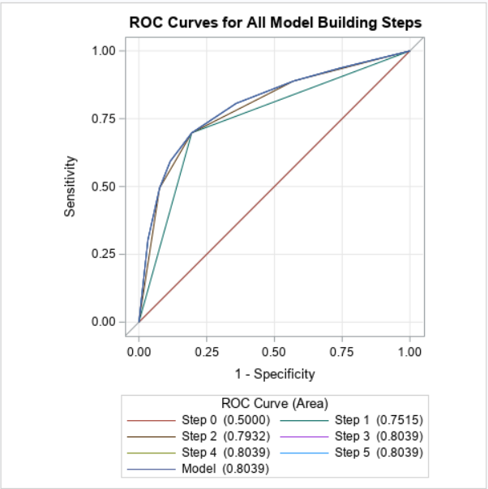
ROC Curve for the Final Model Selected
Conclusion : The AUC value lies between 0.5 to 1 where 0.5 denotes a bad classifier and 1 denotes an excellent classifier.
Here AUC = 0.8039, which is near to 1 that means it is a good model.

Slide 31
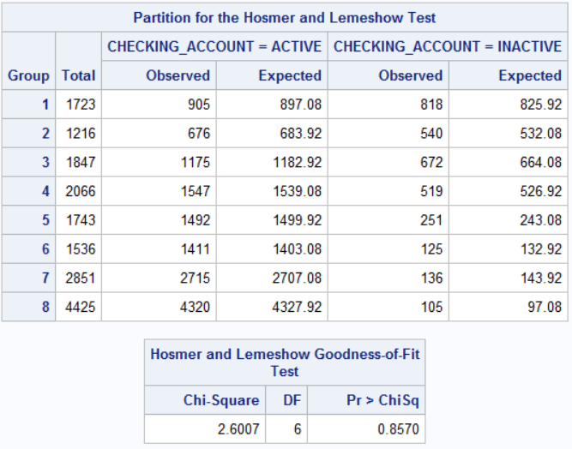
Hosmer and Lemeshow Test
The Hosmer and Lemeshow goodness of fit (GOF) test is a way to assess whether there is evidence for lack of fit in a logistic regression model. Simply put, the test compares the expected and observed number of events in bins defined by the predicted probability of the outcome
The partition table shows the observed and expected count or events in each decile of the predicted probabilities.
A large value of Chi-squared (with small p-value < 0.05) indicates poor fit and small Chi-squared values (with larger p-value closer to 1) indicate a good logistic regression model fit.

Slide 32
RESULTS AND CONCLUSION

Slide 33
Final Results of the Analysis
Using the stepwise selection method, the best model came out was having three variables ATM, INSTALLMENT AND CREDIT CARD and the result was 80.4% which indicates a good-fit model.
Customer using Credit cards are the most Active customers and banks should give them some offers so that they can retain them long either by increasing the Credit Limit of the most valuable customers or give them some offers on the shopping through credit cards. Interest is the source of handsome revenue for the banks.
Those customers who are having loan installments with the banks also turned out to be the Active customers. In that case, Bank should try to convert or retain them as a long-lasting customers by offering them good services as may be they are with the bank till their loan period.
ATM helps the customers to avoid long teller lines to withdraw and deposit cash which make them Active customers as well but on the other hand it is a benefit for the banks too as they charge Certain fees for doing the transactions which is also a major revenue for them.
So, This is not a bad model though, however, we still have a larger scope to improve the model by using other variables.

Slide 34
Recommendations
Bank should concentrate more on the Card users’ customers as they are the one who are the most Active customers and bringing revenue to the banks
In order to pay the loan instalments on time, the customers having loan with the bank comes out to be an active customer. Bank should try them to make their Potential customers.
Bank should try to improve the Teller Services and Phone Banking services in order to retain more customers.
Bank should provide complementary Direct Deposit Facility to entertain more customers.
As per the Age group, Bank should concentrate more on Young and Adult Age Group as they are not that much satisfied with the bank services.
In terms of Area , the branches in Rural and Semi-urban are not doing well, bank should taken this into consideration.
The Branches B4 and B2 are the oldest branches but as they are having maximum inactive customers so bank should find out the reason behind that. May be these branches are using old style of Banking habits.
Bank should also try to convert the Loan customers to their potential customers.

Slide 35
APPENDIX
/*MACRO PROGRAM TO ASSIGN THE LIBRARY*/
%LET DIR =C:\Users\Veena Nigam\Desktop\SAS Documents\SAS Business Project ;
%PUT &DIR.;
%LET DSN = RIMA.PROJECT4;
LIBNAME RIMA "&DIR.";
/*Describing the properties of the project data*/
PROC CONTENTS DATA = &DSN. OUT =CONTENTS VARNUM SHORT;
RUN;
/*DATA PROFILING*/
%MACRO PROF_NUMERIC(DSN = , VAR= );
%LET N = %SYSFUNC(COUNTW(&VAR.));
%DO I = 1 %TO &N;
%LET X = %SCAN (&VAR, &I);
TITLE "DISTRIBUTION OF ALL NUMERIC VARIABLES:SUMMARY";
PROC MEANS DATA = RIMA.RISK N NMISS Q1 Q3 MEAN MEDIAN MAX;
VAR &X.;
RUN;
TITLE "DISTRIBUTION OF &X. : HISTOGRAM AND DENSITY CURVE";
PROC SGPLOT DATA = &DSN.;
HISTOGRAM &X.;
DENSITY &X./ TYPE=KERNEL;
KEYLEGEND/LOCATION=INSIDE POSITION = TOPRIGHT ACROSS=1 NOBORDER;
RUN;
QUIT;
TITLE "DISTRIBUTION OF &X. :VERTICLE BOX PLOT";
PROC SGPLOT DATA = &DSN.;
VBOX &X..;
YAXIS GRID;
XAXIS DISPLAY=(NOLABEL);
RUN;
QUIT;
%END;
%MEND;
ODS PDF FILE = "&DIR.\NUMERIC_SUMMARY_&SYSDATE9..PDF";
%PROF_NUMERIC (DSN = &DSN., VAR = &NUM_ONLY);
ODS PDF CLOSE;
/*CHARACTER VARIABLES*/
%LET X = %SCAN(&CHAR_ONLY.,1);
%PUT &X;
%LET X = %SCAN(&CHAR_ONLY.,2);
%PUT &X;
%MACRO PROF_CHAR(DSN = ,CVAR = , COLOR= );
TITLE "COUNT OF ALL CATEGORICAL VARIABLES:SUMMARY";
PROC FREQ DATA= &DSN. ORDER=FREQ;
TABLE &CVAR./MISSING;
RUN;
%LET N = %SYSFUNC(COUNTW(&CVAR.));
%DO I = 1 %TO &N;
%LET X = %SCAN(&CVAR.,&I);
TITLE "COUNT BY %UPCASE(&X)";
PROC FREQ DATA = &DSN. ORDER=FREQ;
TABLE &X./MISSING;
RUN;
TITLE "COUNT BY %UPCASE(&X.)";
PROC SGPLOT DATA = &DSN.;
VBAR &X/categoryorder=respasc barwidth=0.6 fillattrs= &COLOR.;
xaxis display=(nolabel);
RUN;
QUIT;
PROC TEMPLATE;
DEFINE STATGRAPH PIE;
BEGINGRAPH;
ENTRYTITLE "COUNT BY %UPCASE(&X.)";
LAYOUT REGION;
PIECHART CATEGORY=&X / DATALABELLOCATION=OUTSIDE DATASKIN = CRISP DATALABELCONTENT = ALL CATEGORYDIRECTION = CLOCKWISE START = 180 NAME = 'PIE' ;
DISCRETELEGEND 'PIE';
ENDLAYOUT;
ENDGRAPH;
END;
RUN;
PROC SGRENDER DATA = &DSN. TEMPLATE = PIE;
RUN;
%END;
%MEND;
%PROF_CHAR(DSN = &DSN.,CVAR = &CHAR_ONLY , COLOR = GRAPHDATA9 );
/*Missing Values Treatment*/
%MACRO MISSING (DSN = , OUT = );
PROC MEANS DATA = &DSN. N NMISS;
RUN;
PROC STDIZE DATA = &DSN. OUT= &OUT. METHOD= MEDIAN REPONLY;
VAR Age Income CRScore;
RUN;
/*Checking if the missing values are replaced by median value*/
PROC MEANS DATA = &OUT. MAXDEC=2 N NMISS;
RUN;
%MEND;
%MISSING(DSN= &DSN_1., OUT = RIMA.BANK_NEW);

Slide 36
APPENDIX
/*Other way to do the Missing Value Treatment of Binary class variable (with mode)*/
%MACRO REPLACE (INPUT= ,STATS= ,VARS= ,OUTPUT= );
* GENERATE ANALYSIS RESULTS ;
PROC UNIVARIATE DATA=&INPUT NOPRINT;
VAR &VARS;
OUTPUT OUT=DUMMY &STATS= &VARS;
RUN;
* CONVERT TO VERTICAL ;
PROC TRANSPOSE DATA=DUMMY OUT=DUMMY;
RUN;
* REPLACE MISSING WITH ANALYSIS RESULTS ;
DATA &OUTPUT;
SET &INPUT;
ARRAY VARS &VARS ;
DO I =1 TO DIM(VARS);
SET DUMMY(KEEP=COL1) POINT= I ;
VARS(I)=COALESCE(VARS(I),COL1);
DROP COL1 ;
END;
RUN;
%MEND;
/*TREATING THE OUTLIERS*/
%MACRO OUTLIER (DATA= , VARNAME = , THRESHOLD= , OUTPUT = );
PROC MEANS DATA = &DATA. MAXDEC=2 N P25 P75 QRANGE;
VAR &VARNAME.;
RUN;
PROC MEANS DATA = &DATA. MAXDEC = 2 N P25 P75 QRANGE;
VAR &VARNAME.;
OUTPUT OUT = RIMA.DEL P25 = Q1 P75 = Q3 QRANGE=IQR;
RUN;
DATA RIMA.TEMP1;
SET RIMA.DEL ;
LOWER_LIMIT = Q1 - (&THRESHOLD.*IQR);
UPPER_LIMIT = Q1 + (&THRESHOLD.*IQR);
RUN;
/*CARTESIAN PRODUCT*/
PROC SQL;
CREATE TABLE RIMA.DATA_01 AS
SELECT A.*,B.LOWER_LIMIT, B.UPPER_LIMIT
FROM &DATA. AS A, RIMA.TEMP1 AS B
;
QUIT;
DATA RIMA.DATA_02;
SET RIMA.DATA_01;
IF &VARNAME. LE LOWER_LIMIT THEN RANGE = "BELOW LOWER LIMIT";
ELSE IF &VARNAME. GE UPPER_LIMIT THEN RANGE = "ABOVE UPPER LIMIT";
ELSE RANGE = "WITHIN RANGE";
RUN;
QUIT;
/*PRINTING WITHIN RANGE DATA*/
PROC SQL;
CREATE TABLE &OUTPUT.(DROP= LOWER_LIMIT UPPER_LIMIT RANGE) AS
SELECT *
FROM RIMA.DATA_02
WHERE RANGE = "WITHIN RANGE";
QUIT;
PROC PRINT DATA=&OUTPUT.;
RUN;
%MEND OUTLIER;
%MACRO RECODE_DDA (DATA = , VAR = , OUTPUT = );
data &OUTPUT.;
set &DATA.;
/* use IF-THEN logic to recode gender */
length CHECKING_ACCOUNT $8;
if &VAR.= 1 then CHECKING_ACCOUNT = "ACTIVE";
else CHECKING_ACCOUNT = "INACTIVE ";
DROP &VAR.;
run;
PROC PRINT DATA = &OUTPUT.;
RUN;
%MEND;
%RECODE_DDA (DATA = RIMA.BANK_UPDATED_0 , VAR = DDA , OUTPUT = RIMA.BANK_UPDATED);
/*GROUPING THE DATA USING HPBIN PROCEDURE*/
%MACRO BIN (DATA = , VAR1 = ,BINS = , OUT =);
PROC HPBIN DATA = &DATA. OUTPUT = &OUT. NUMBIN = &BINS.;
INPUT &VAR1.;
RUN;
%MEND;
%BIN (DATA = RIMA.BANK_UPDATED , VAR1 = AGE , BINS = 3 , OUT = RIMA.BANK1);

Slide 37
APPENDIX
/*--Macro Program to find the effect of banking habits on the customers*/
%macro RGBHex(rr,gg,bb);
%sysfunc(compress(CX%sysfunc(putn(&rr,hex2.))
%sysfunc(putn(&gg,hex2.))
%sysfunc(putn(&bb,hex2.))))
%mend RGBHex;
proc template;
define statgraph BarPie;
dynamic _tsize _lsize;
begingraph;
entrytitle "Customers Satisfaction Count using Phone Banking as per the Area" / textattrs=(size=_tsize);
/*--Define an attribute map to use specific colors by type--*/
discreteattrmap name='PHONE_N' / ignorecase=true;
value 'YES' / fillattrs=(color=%rgbhex(100, 150, 40));
value 'NO' / fillattrs=(color=%rgbhex(180, 110, 50));
enddiscreteattrmap;
/*--Associate the Attribute Map to the TYPE variable--*/
discreteattrvar attrvar=type var=type attrmap='PHONE_N';
/*--Define a one row x two columns layout --*/
layout lattice / columns=2 columnweights=(0.6 0.4) columngutter=20;
/*--First cell has a Bar Chart--*/
layout overlay / xaxisopts=(display=(tickvalues)) walldisplay=none
yaxisopts=(display=(tickvalues) linearopts=(tickvalueformat=percent.)
griddisplay=on offsetmax=0.2);
barchart category=PHONE_N / name='Y' barlabel=true stat=proportion
dataskin=pressed group=RES groupdisplay=cluster barlabelformat=percent6.1
baselineattrs=(thickness=0) barlabelattrs=(size=_lsize) grouporder=descending
/*--FILLTYPE= requires SAS 9.4 (TS1M2) or later--*/
filltype=gradient
;
discretelegend 'Y' / location=inside halign=center valign=top autoitemsize=true valueattrs=(size=_lsize);
endlayout;
/*--Second cell has a Pie Chart--*/
layout region / pad=(bottom=30);
piechart category=RES / dataskin=sheen centerfirstslice=true start=270 stat=pct
datalabelattrs=(size=_lsize);;
endlayout;
endlayout;
endgraph;
end;
run;
/*--Render the graph--*/
ods listing style=listing gpath=&graphs image_dpi=&dpi;
ods graphics / reset width=&w height=&h imagename='BarPie';
proc sgrender data=RIMA.HABIT template=BarPie;
dynamic _tsize=16 _lsize=13;
run;
/*Which branches are offering the direct deposit facilities*/
title"COMPLEMENTORY DIRECT DEPOSIT OFFERED BY VARIOUS BRANCHES";
proc sgplot data=&DSN_2. noautolegend;
waterfall category=BRANCH response=DIRDEP/ colorgroup=checking_account dataskin=sheen datalabel name='a';
keylegend 'a' / location=outside position=topright across=1;
xaxis display=(nolabel);
yaxis grid display=(nolabel) offsetmin=0;
run;
/*Which branch is having the maximum number of Inactive customers?*/
proc template;
define statgraph barchart;
begingraph / attrpriority=none;
entrytitle "ACTIVE/INACTIVE CUSTOMERS AS PER THE BRANCHES";
layout overlay;
barchart x=CHECKING_ACCOUNT / name="BRANCHES"
stat=pct display=all
group=BRANCH groupdisplay=cluster group100=positive
barlabel=true;
discretelegend "BRANCHES";
endlayout;
endgraph;
end;
run;
proc sgrender data=&dsn_2. template=barchart;
run;
/*Which is the oldest Branch as per the age of the Account?*/
proc template;
define statgraph barchart;
begingraph;
entrytitle "Oldest Branch as per the Account Age";
layout overlay;
barchart category=branch response=acctage/ name="bar"
stat=mean orient=horizontal
colorbyfreq=true colorstat=pct;
continuouslegend "bar" /
title="Percent of age of the Account";
endlayout;
endgraph;
end;
run;
proc sgrender data=rima.project4 template=barchart;
run;
/*What type of Income people are the most active customers in the different branches of the bank ?*/
DATA RIMA.INCOME;
SET &DSN_2.;
IF INCOME LE 50 THEN INCOME_1= 0;
ELSE IF 51< INCOME <=100 THEN INCOME_2 = 1;
ELSE INCOME_3 =2;
RUN;
proc template;
define statgraph barchart;
begingraph;
entrytitle "INCOME GROUP AS PER THE AREA";
layout overlay / cycleattrs=true
xaxisopts=(display=(tickvalues))
yaxisopts=(label="INCOME" offsetmax=0.2);
barchart category=BRANCH response=INCOME_1 / stat=sum name="POOR INCOME"
legendlabel="POOR INCOME" datatransparency=0.2
discreteoffset=-0.2 barwidth=0.5 ;
barchart category=BRANCH response=INCOME_2 / stat=sum name="AVERAGE INCOME"
legendlabel="AVERAGE INCOME" datatransparency=0.2
discreteoffset=0 barwidth=0.5 ;
barchart category=BRANCH response= INCOME_3 / stat=sum name="HIGHER INCOME"
legendlabel="HIGHER INCOME" datatransparency=0.2
discreteoffset=+0.2 barwidth=0.5 ;
discretelegend "POOR INCOME" "AVERAGE INCOME" "HIGHER INCOME" / title="INCOME:"
location=inside halign=right valign=top;
endlayout;
endgraph;
end;
run;
proc sgrender data= RIMA.INCOME template=barchart;
run;

Slide 38
APPENDIX
/*FINAL VARIABLE SELECTION*/
/*SAS MACRO : VARIABLE SELECTION BASED ON WALD CHI-SQUARE*/
/*Variable Selection based on Univariate Analysis (Wald Chi-Square and Standardized Coefficient)*/
/*PROC LOGISTIC is run on each of the variables and tracking p-value of wald chi-square and standardized coefficient*/
%macro perf(data=,targetvar=,vars=,output=);
%let n=%sysfunc(countw(&vars));
%do i=1 %to &n;
%let val = %scan(&vars,&i);
ods select none;
ods output ParameterEstimates=Estimate&i;
proc logistic data=&data;
model &targetvar(event='1')=&val / stb;
run;
data Estimate&i;
set Estimate&i;
length Sig $15;
where Variable NE 'Intercept';
if ProbChiSq < .05 then Sig ='Significant';
else if ProbChiSq >= .05 then Sig = 'Non-Significant';
help = abs(StandardizedEst);
run;
%end;
data &output;
set Estimate1 - Estimate&n;
run;
proc datasets library=work
nodetails nolist;
delete Estimate1 - Estimate&n;
run;
quit;
proc sort data = &output;
by descending help;
run;
data &output;
set &output(DROP=HELP);
run;
%mend perf;
/*SPLITING THE DATA INTO TRAINING AND TESTING*/
PROC SURVEYSELECT DATA= RIMA.BANK_DATA OUT= RIMA.MODEL_DATA RATE=0.7 OUTALL;
RUN;
PROC FREQ DATA = RIMA.MODEL_DATA;
TABLE SELECTED/MISSING;
RUN;
DATA TRAINING TESTING;
SET RIMA.MODEL_DATA;
IF SELECTED EQ 1 THEN OUTPUT TRAINING;
ELSE OUTPUT TESTING;
RUN;
/*MODEL 1*/
PROC LOGISTIC DATA= TRAINING plots(only MAXPOINTS=NONE)=(roc ODDSRATIO);
class CC(param=ref ref="1") CCPURC(param=ref ref="1") mtg(param=ref ref="1") ins(param=ref ref="1") atm(param=ref ref="1");
model checking_account(event="active") = cc|ccpurc|mtg|ins|atm/CLODDS=PL;
oddsratio CC;
oddsratio CCPURC;
oddsratio mtg;
oddsratio ins;
oddsratio atm;
OUTPUT OUT = BANK_PROB P = PRED_PROB;
RUN;
QUIT;
/*INTERACTIONS*/
TITLE "RUNNING A LOGISTIC REGRESSION MODEL WITH INTERACTIONS";
PROC LOGISTIC DATA = TRAINING plots(only MAXPOINTS=NONE)=(roc ODDSRATIO) ;
class CC(param=ref ref="1") CCPURC(param=ref ref="1") mtg(param=ref ref="1") ins(param=ref ref="1") atm(param=ref ref="1");
model checking_account(event="active") = cc|ccpurc|mtg|ins|atm @2/CLODDS=PL SELECTION= BACKWARD SLSTAY=0.1;;
oddsratio CC;
oddsratio CCPURC;
oddsratio mtg;
oddsratio ins;
oddsratio atm;
OUTPUT OUT = BANK_PROB P = PRED_PROB;
RUN;
QUIT;
/* Creating Logistic regression model using stepwise selection method */
Title"Logistic Regression Model using Stepwise Selection Method";
proc logistic data=training plots(only MAXPOINTS=NONE)=(roc ODDSRATIO);
class CC CCPURC atm mtg ins;
model checking_account(event="active") = cc|CCPURC|atm|mtg|ins/selection=stepwise expb stb lackfit;
oddsratio CC ;
oddsratio CCPURC;
oddsratio atm;
oddsratio mtg;
oddsratio ins;
output out = temp p=new;
store bank_logistic;
run;
*MODEL SCORING: TRAINING AND TESTING;
*1. ;
TITLE "MODEL SCORING : SCORING OPTION";
PROC LOGISTIC DATA = TRAINING plots(only MAXPOINTS=NONE) ;
class CC CCPURC atm mtg ins;
model checking_account(event="active") = cc|CCPURC|atm|mtg|ins @2/CLODDS=PL SELECTION= BACKWARD SLSTAY=0.1 ;
OUTPUT OUT= TEST P=PROB;
SCORE DATA = TESTING OUT=TESTING_SCORE_FINAL;
RUN;
QUIT;

Slide 39
THANK
YOU !!!

